Slide 1
VIDEO GAME SALES
DWI REFARIANTO NUGROHO

Slide 2
BACKGROUND
Games have always existed in a numbers-obsessed industry. Sega vs. Nintendo defined a generation in the '90s, while today's comparatively mild console wars and monthly NPD reports keep sales figures near the forefront of games-related discussion. New monetization models require new metrics for success — monthly active users, player retention rates, in-game revenue, etc. — but one of the industry's biggest questions remains: What are the best-selling video games of all time?
Over the past 40 years, a veritable industry has grown up around the design, development, and delivery of video games for home video game consoles and the personal computer. Collectively called the “video game industry,” these endeavors have greatly evolved from a cottage industry in the 1970s to a goliath that rivals the film industry for household entertainment expenditures. As the U.S. is the world’s biggest video games market and manufacturer, the U.S. video game market is now worth over $20 billion annually in software and hardware sales; which is more than four times the market size in the 1990s
To answer this question we need to analyze sales performance of video games

Slide 3
Scope of Problem
Objectives
How are the sales performances of video games in each region How is trend of sales performance from 1980-2016
The evolution of global sales over time.
The evolution of sales by regions over time.
The evolution of sales for a specific platform over time.
The best-selling video games.
Global sales by genres.
Global sales by platforms.
Genre distribution within a platform.
Sales generated by a genre on various platforms.
Comparing sales by regions between two platforms.

Slide 4
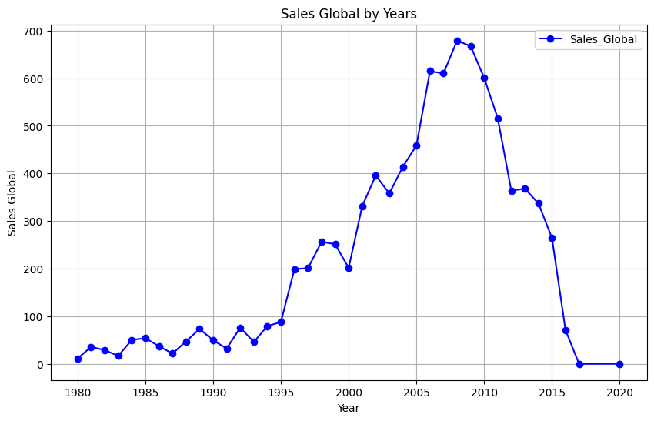
Trend of global sales year by year

Slide 5
In this graph, we can observe that sales have been on the rise over the years, with the highest point being in 2008. However, starting from this year, sales begin to decline, with zero sales recorded between 2017 and 2020. This could be due to the data not being recorded in this time range or that, starting from a certain year, the entity responsible for recording this information has ceased to do so or lacked the resources to continue this work actively. It's important to consider these factors when interpreting the data.

Slide 6
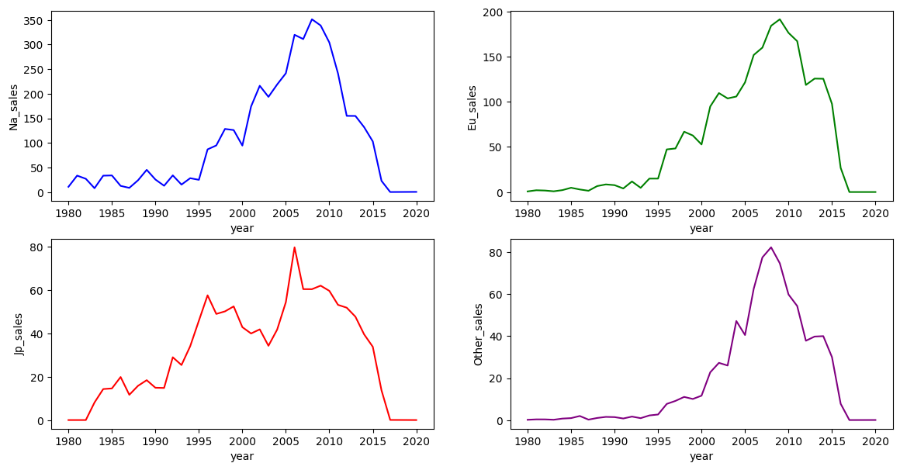
Trend of each region sales year by year

Slide 7
In the regional evaluation, we can observe a similar upward trend as in the global assessment. It's worth noting the growth in sales in Japan, where we can see a decline in sales compared to other regions between 1998 and 2004. Due to the lack of information, we cannot draw a conclusion about what happened during this period. We cannot determine, for example, if there was a shift in trends due to changes in leisure preferences or other factors. Additional data or research would be needed to understand the specific reasons behind this fluctuation.

Slide 8
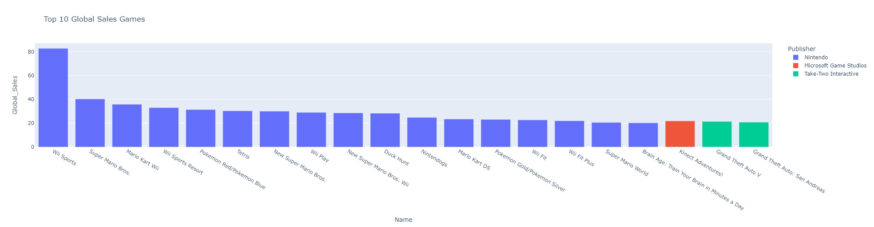
Top 10 Global Sales Games

Slide 9
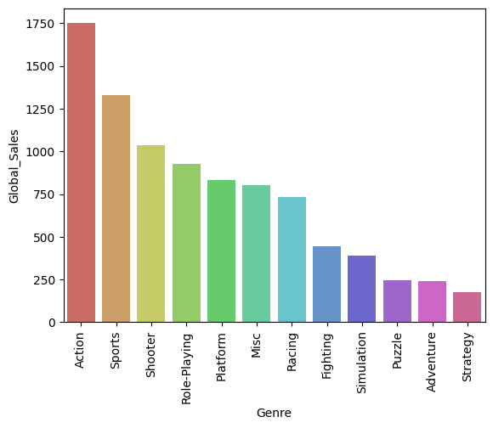
Global Sales by Genre
Rank | Genre | Global Sales (in Millions USD)
1 | Action | 1750.33
2 | Sport | 1329.35
3 | Shooter | 1037.32

Slide 10
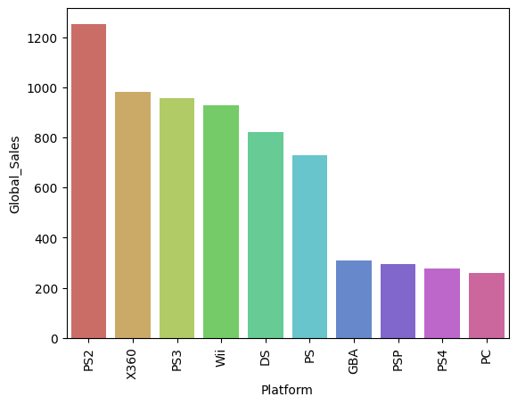
Global Sales by Platform
Rank | Platform | Global Sales (in Millions USD)
1 | PS2 | 1252.43
2 | X360 | 979.89
3 | PS3 | 957.29

Slide 11
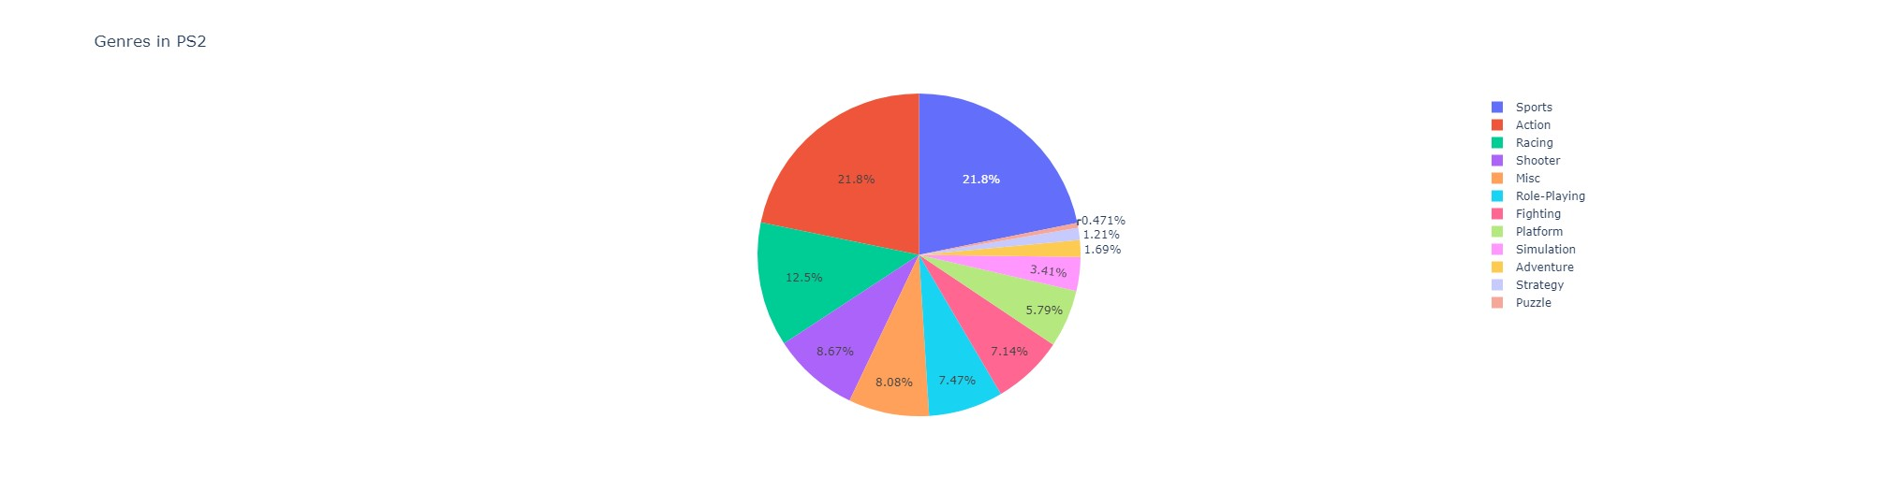
Genre distribution within a platform (PS2)

Slide 12
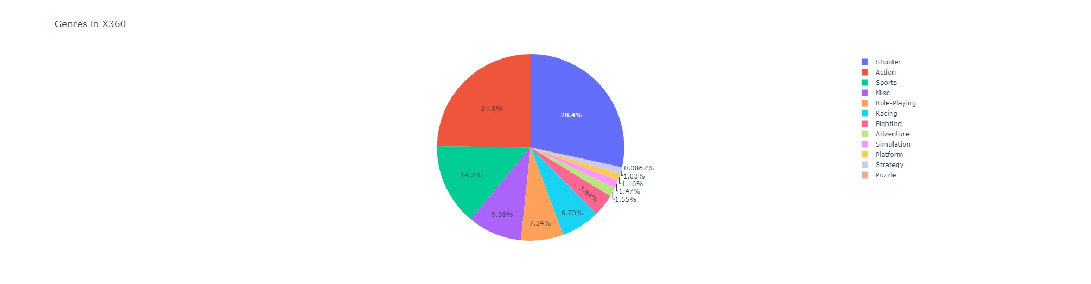
Genre distribution within a platform (Xbox360)

Slide 13
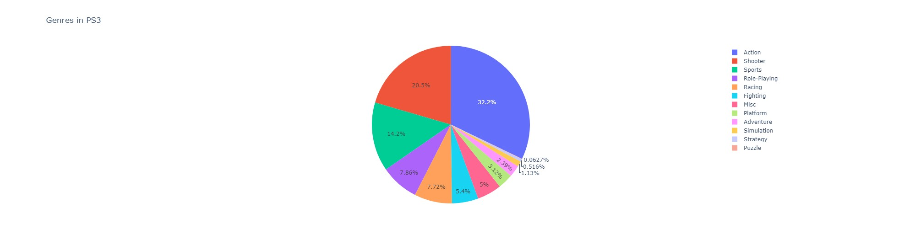
Genre distribution within a platform (PS3)

Slide 14
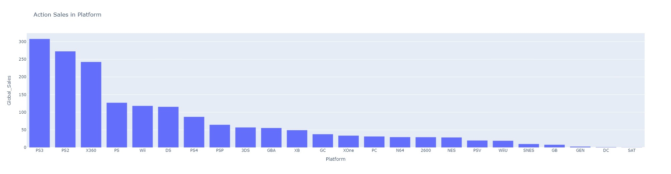
Sales generated by a genre on various platforms

Slide 15
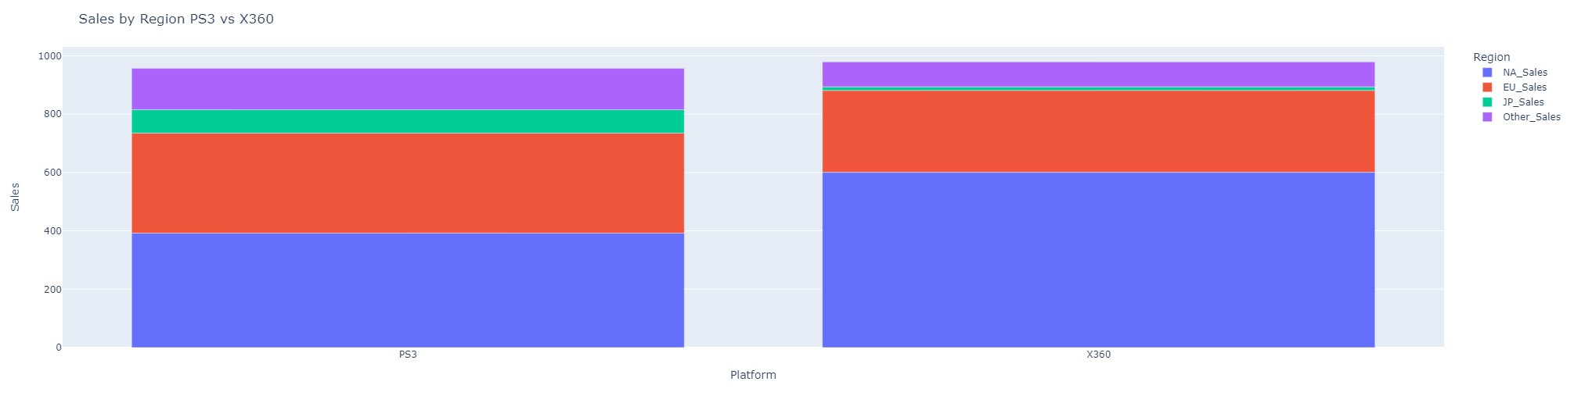
Sales by region PS3 v XBOX360

Slide 16
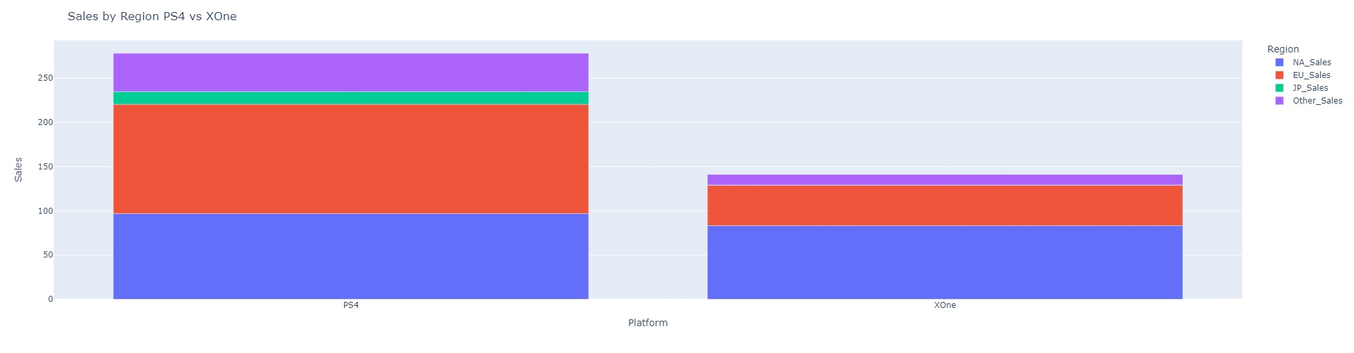
Sales by region PS4 v XBOX One

Slide 17
Conclusion and Recommendation
Conclusion :
From the dataset, it can be concluded that the data was collected from 1980-2016.
There was a significant increase in video game sales in the early 2000s.
Video games from publisher Nintendo occupy the top 10 global sales.
The action genre is the most popular genre
Recommendation :
Focuses sales on action, sport, and shooter genre
Focuses sales on video game platforms on platforms such as PlayStation, Xbox, and Wii rather than PC

Slide 18
Dataset : https://drive.google.com/file/d/1rsBNZdo4_joPn9_iUOJJWKgo6OhL0YHn/view?usp=drive_link Google Colaboratory : https://colab.research.google.com/drive/1KPIKpUjp7jRGHZRbveezLJOcSF3xmUzC?usp=sharing

